Slide 1
Winforms: Radio Buttons
Grouping Controls

Slide 2
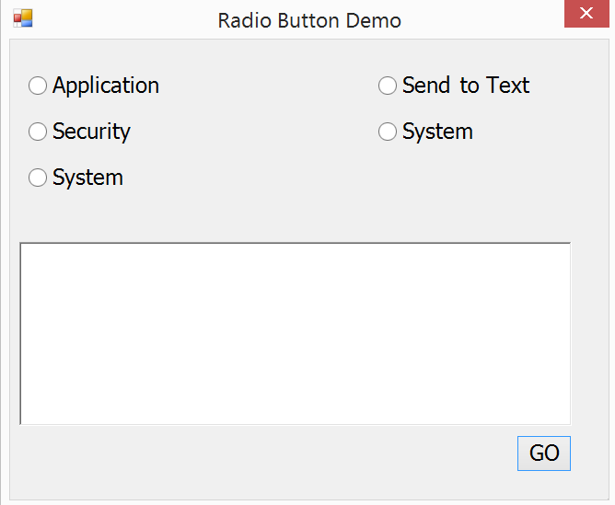
Your Starting Point: Radio Buttons Aren’t Functioning as 2 Separate Groups

Slide 3
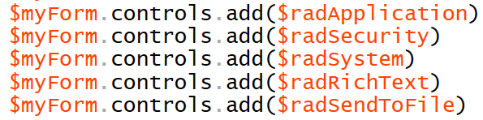
Adding Radio Buttons to a Group
First, we will not add the radio buttons to the form Delete the commands, above
Then we will make 2 different group boxes
We will add radio buttons to each group box’s controls collection
Then we will add the 2 group boxes to the form

Slide 4
Capturing a Radio Button Value
To access what a radio button stores, you get its Text property
But because you have many radio items for one group, and they act in a mutually exclusive fashion, you need to see which one is checked first
We use the checked property to do that
Let’s look at coding getting the value in 2 different ways in the getEventLog function
via if/elseif or if/else
iteration through a group box

Slide 5

Finalizing the code
Once we have the 2 checked radio button values, we can complete the code for getEventLog

